Slide 1

Introduction to Spreadsheet
બેઝિક સ્પ્રેડશીટ
CSR Initiative of Tata Power & Sai’s Angel Foundation, Vadodara
Notes:
સ્પ્રેડ શીટ

Slide 2
Basic Data Entry
Roll Number | Name | Age | Weight (kg)
101 | Rajesh | 14 | 45.5
102 | Priya | 13 | 38.2
103 | Manish | 15 | 52.3
104 | Ananya | 14 | 44
105 | Suresh | 12 | 36.8
106 | Kavita | 16 | 50.5
107 | Rohit | 13 | 39.7
108 | Meera | 14 | 41.5
109 | Rahul | 15 | 49.8
110 | Aishwarya | 14 | 43.2

Slide 3
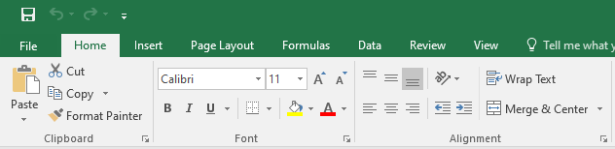
Home Menu
Basic Copy Paste & Basic Formatting Practice with Clipboard, Font, Alignment

Slide 4
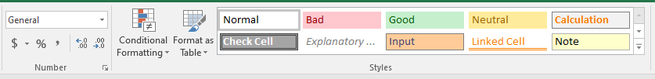

Slide 5


Slide 6
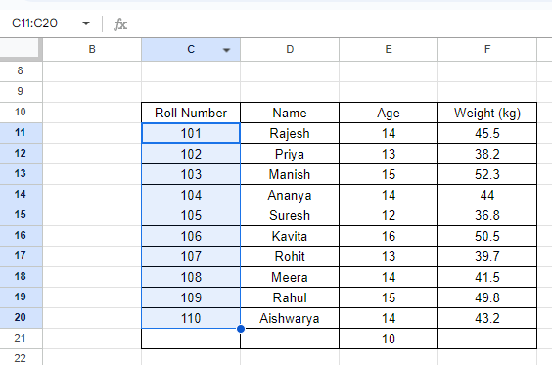
Range
C11:C20

Slide 7
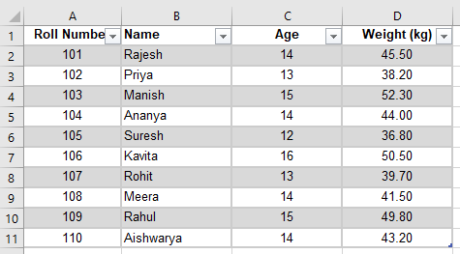
Challenge 1
Hint - Use Format as Table in home menu

Slide 8
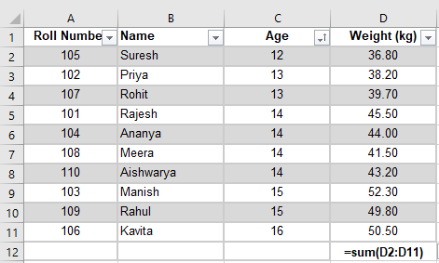
Challenge 2

Slide 9
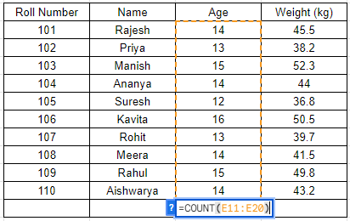
Challenge 3
=Count(Range)

Slide 10
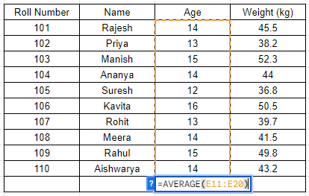
Challenge 4
=AVERAGE(Range)

Slide 11
Challenge 5
Suppose cell A1 contains the weight in kg (e.g., 70) and cell B1 contains the height in cm (e.g., 175), you can enter the formula in another cell, say C1: =ROUND((A1 / ((B1 / 100) ^ 2)), 2)

Slide 12
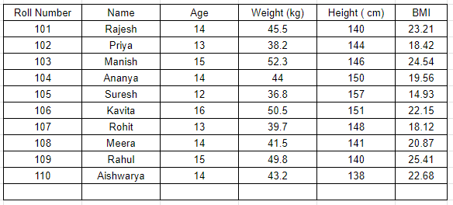

Slide 13
Make a Height-Weight BMI Spreadsheet for your class
Challenge 6

Slide 14
Keywords to Learn about Excel
Basics of Excel in Gujarati
Basics of Functions in Excel Gujarati
Basics of printing and page setup in excel

Slide 15

કોઈ જગ્યાએ કંઈ ન સમજાયું હોય
હાથ ઉપર કરો અને પૂછો
Notes:
હાથ ઉપર કરો અને પૂછો

